Slide 1
MULTIPLE REGRESSION MODEL - I

Slide 2
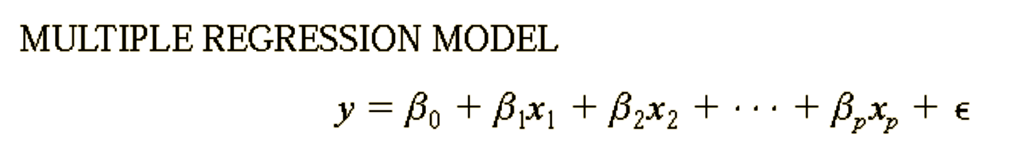
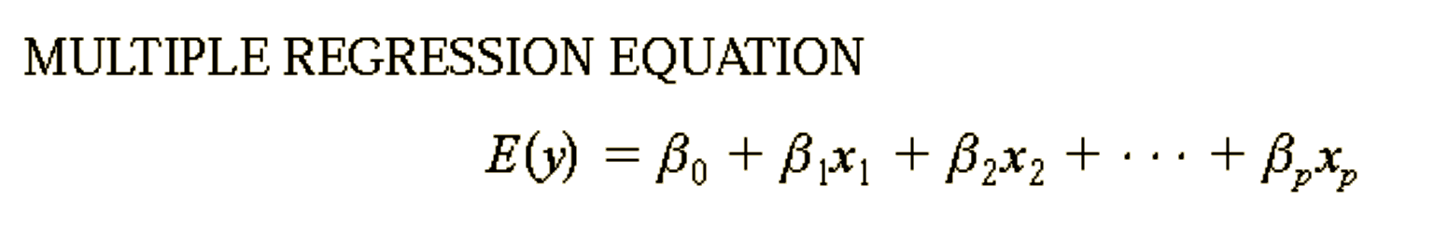
Multiple regression model

Slide 3
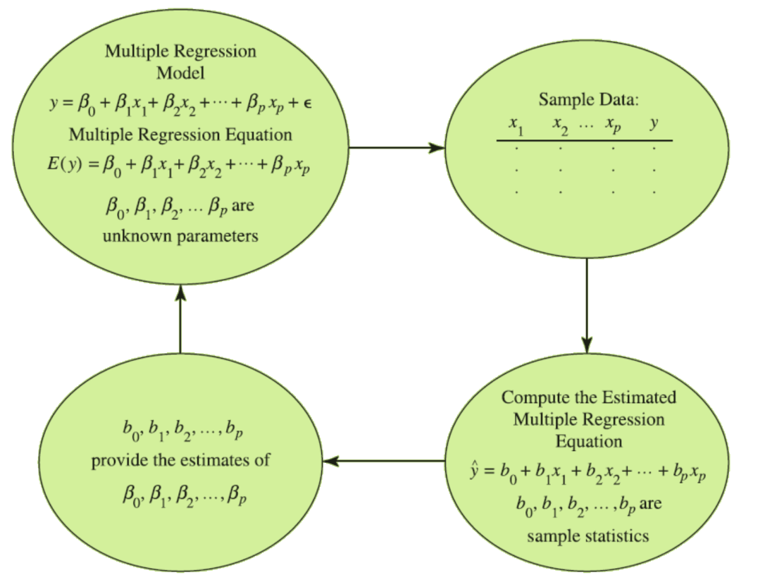
The estimation process For multiple regression

Slide 4
Simple vs multiple regression
In simple linear regression, b₀ and b₁ were the sample statistics used to estimate the parameters β ₀ and β ₁.
Multiple regression parallels this statistical inference process, with b₀,b₁, b₂, . . . , b_{p} denoting the sample statistics used to estimate the parameters
β ₀, β ₁, β ₂, . . . , β _{p}.

Slide 5
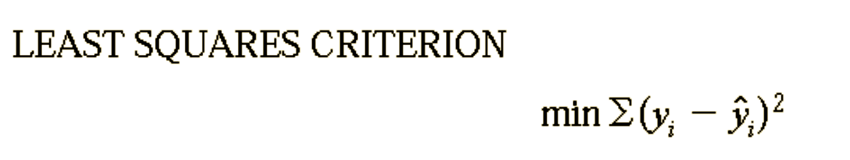
Least Squares Method

Slide 6
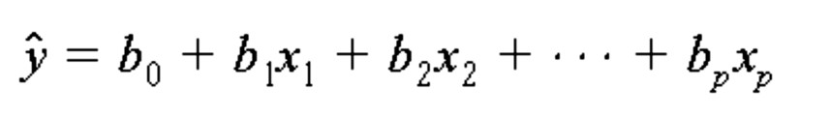
Least Squares Method

Slide 7
An Example: Trucking Company
As an illustration of multiple regression analysis, we will consider a
problem faced by the Trucking Company.
A major portion of business involves deliveries throughout its local area.
To develop better work schedules, the managers want to estimate the
total daily travel time for their drivers.
Source: Statistics for Business and Economics, 2012, Anderson

Slide 8
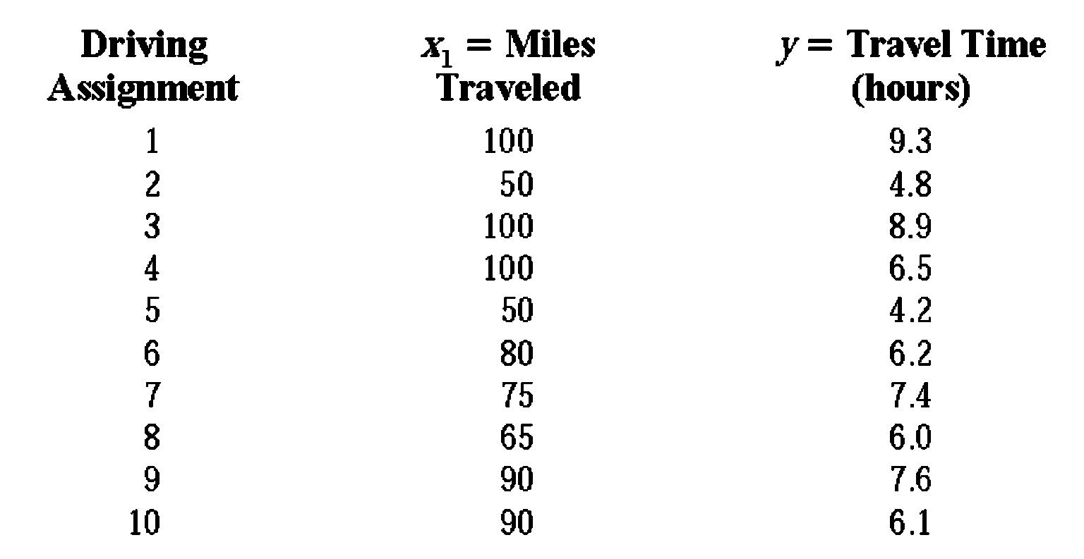
PRELIMINARY DATA FOR BUTLER TRUCKING

Slide 9
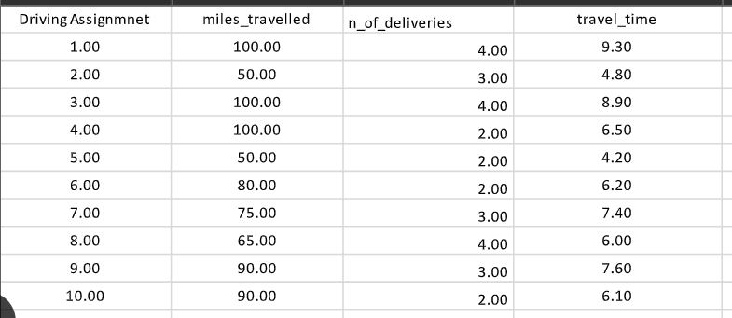
Dataset
x1

Slide 10
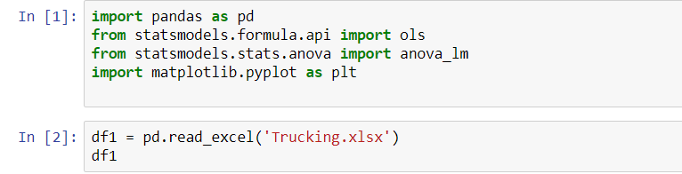
Using python import data

Slide 11
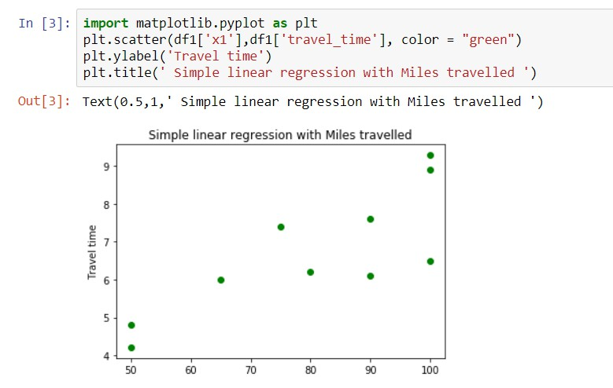


Scatter Diagram Of Preliminary Data For Trucking x₁
Miles travelled X1

Slide 12
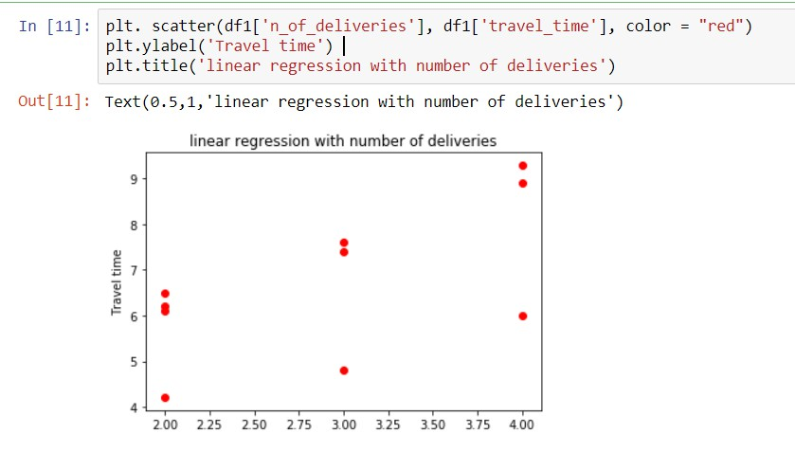
Scatter Diagram Of Preliminary Data For Trucking x₂

Slide 13
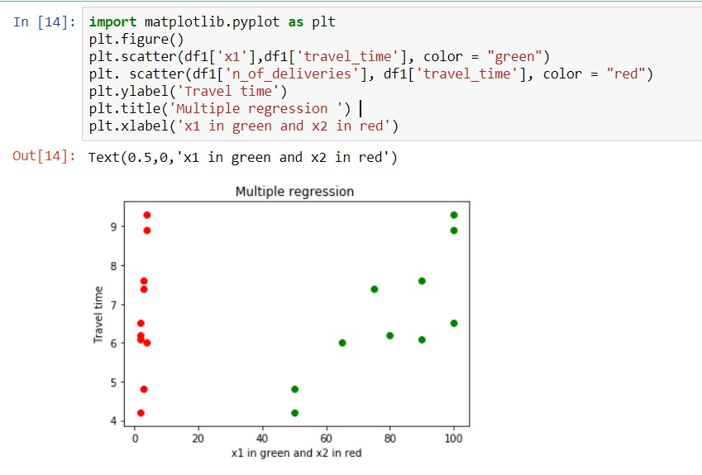
Scatter Diagram For x₁ and x₂

Slide 14
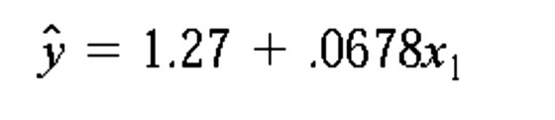
Linear regression Vs. multiple regression model
Linear regression

Slide 15
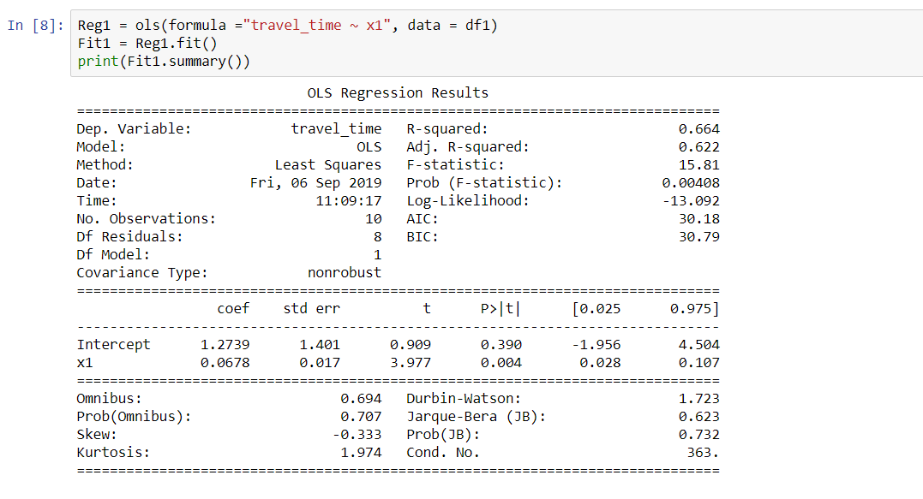





Linear regression Vs. multiple regression model

Slide 16
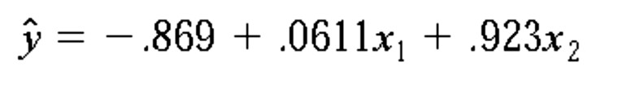
Linear regression Vs. Multiple regression model
Multiple regression

Slide 17
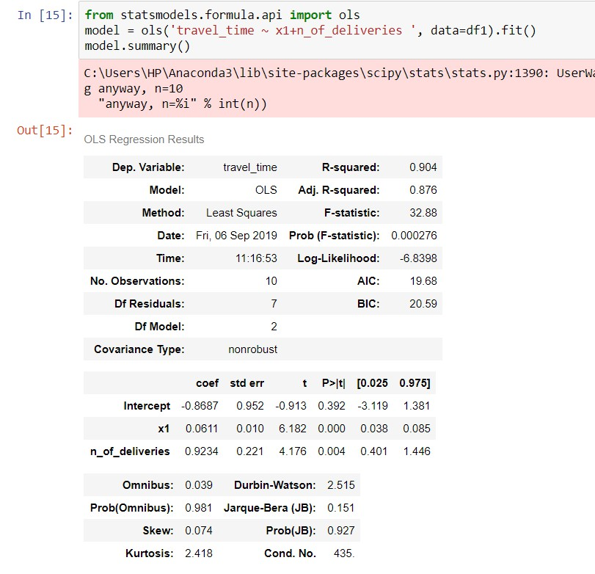

Linear regression Vs. Multiple regression model

Slide 18
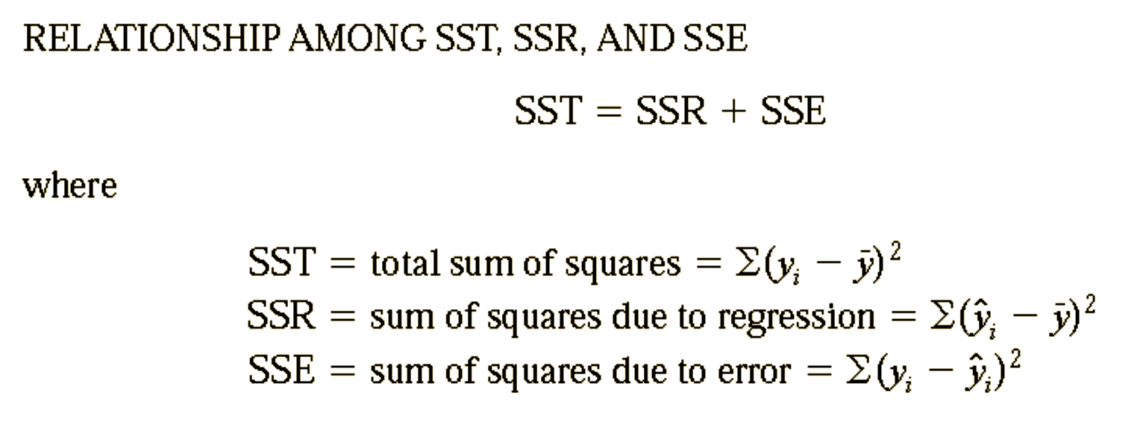
Multiple Coefficient of Determination

Slide 19
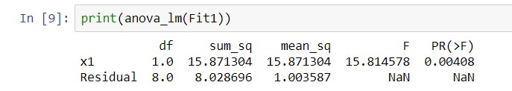








Multiple Coefficient of Determination for linear model

Slide 20

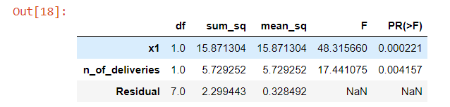







Multiple Coefficient of Determination for Multiple regression model

Slide 21
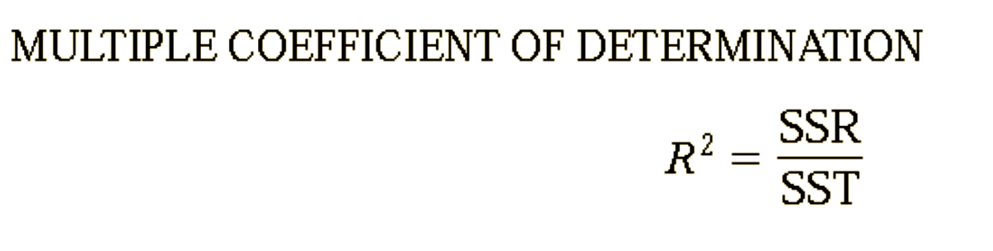
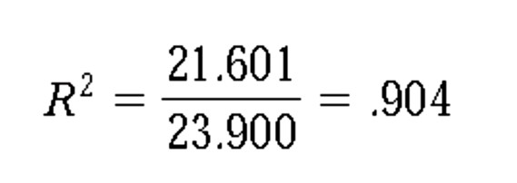
Multiple Coefficient of Determination

Slide 22




Multiple Coefficient of Determination
Adding independent variables causes the prediction errors to become smaller, thus reducing the sum of squares due to error, SSE.
Because SSR = SST- SSE, when SSE becomes smaller, SSR becomes larger, causing R² = SSR/SST to increase.
Many analysts prefer adjusting R² for the number of independent variables to avoid overestimating the impact of adding an independent variable on the amount of variability explained by the estimated regression equation.

Slide 23






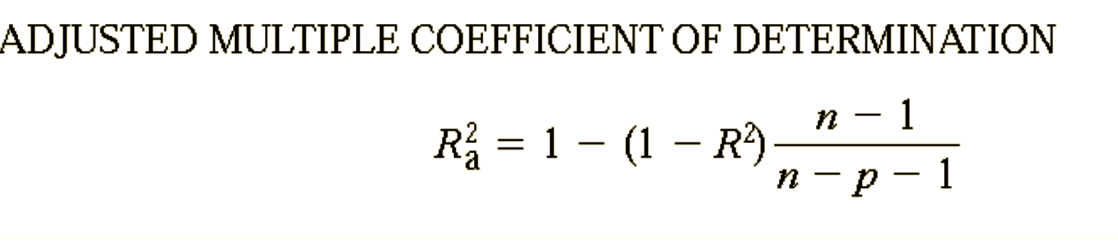
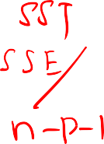

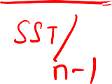
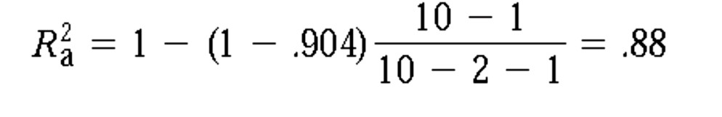
Adjusted Multiple Coefficient of Determination
n = number of observations
p = denoting the number of independent variables

Slide 24




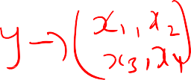










OLS Summary

Slide 25
Adjusted Multiple Coefficient Vs Multiple Coefficient
If a variable is added to the model, R² becomes larger even if the variable added is not statistically significant.
The adjusted multiple coefficient of determination compensates for the number of independent variables in the model.

Slide 26
Adjusted Multiple Coefficient Vs Multiple Coefficient
If the value of R² is small and the model contains a large number of independent variables, the adjusted coefficient of determination can take a negative value

Slide 27
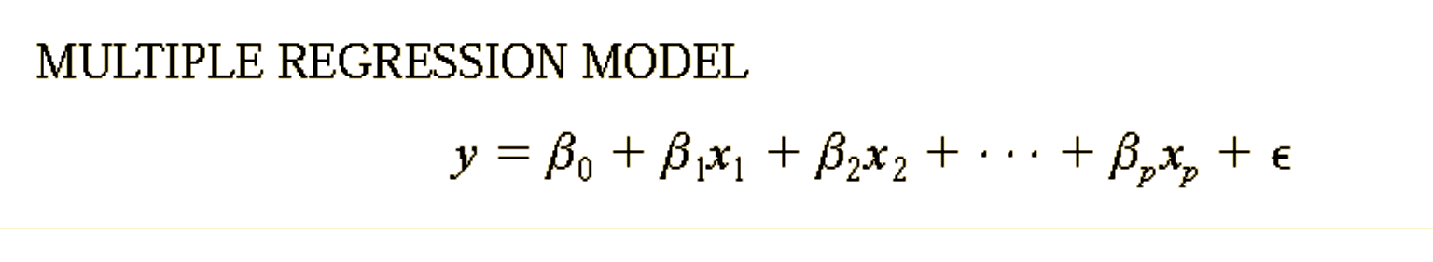






Model Assumptions

Slide 28
Assumption about error term
1. The error term ε is a random variable with mean or expected value of zero;
E(ε) = 0.
Implication: For given values of x₁,x₂,…,x_{p} the expected , or average , value of y is given by E(y) = β₀+β₁x₁+β₂ x ₂+....+β_{p}x_{p}
– This equation represents the average of all possible values of y , that
might occur for the given value of x₁,x₂,…,x_{p}, by E(y).

Slide 29
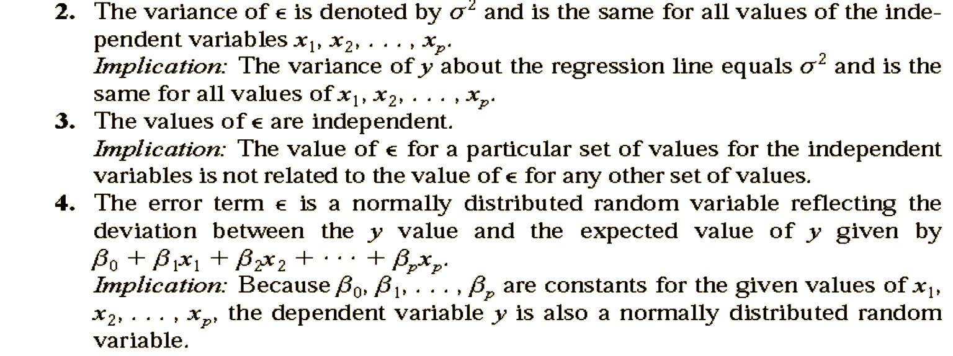
Assumption about error term

Slide 30
Thank You

